Slide 1
Analysing direct and indirect causes along with PASC through a proactive model
Mental health
Depression & Anxiety
Authors
Surabhi Summi
Caitlin Salerno
Baishakhi Mitra
Nimesh Gala

Slide 2
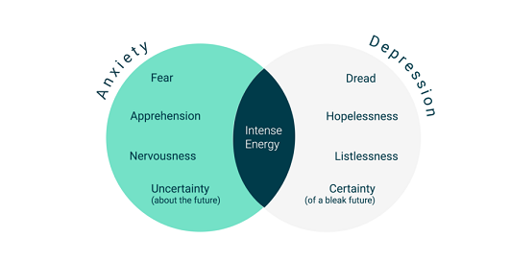
Can we control depression and anxiety disorder?
The national institute of Mental Health (NIHM) states that anxiety disorder often interferes with daily activities and job performance and has long lasting effects.
Depression (clinical depression) on the other hand is a serious mood disorder that affects how a person thinks or behaves in daily life.
Through this project we aim to analyse the various direct and indirect factors that leads to these medical conditions.
We will focus on different aspects of human life , such as , lifestyle, illnesses, economic condition, social condition, family support, substance abuse, drugs etc. Through our models , we aim to come to conclude to what extent these factors are responsible for these medical conditions and how we can reduce the risk.

Slide 3
About the Data
We are taking data from the National Health Interview Survey (NHIS) from 2020. This data takes a sample of 31,568 individuals, asking them questions about all aspects of their health and socio-economic conditions.
There are 618 variables in this dataset, and we have deemed 202 of these variables to be important in our analysis towards factors that could affect Anxiety and Depression levels, our two outcome variables that we will create two different models for. After analyzing each of these variables, we are creating models based on a total of Other variables in this study were either not important factors of our outcome variables or were heavily related to the 51 chosen variables and therefore had too much multicollinearity to include.

Slide 4
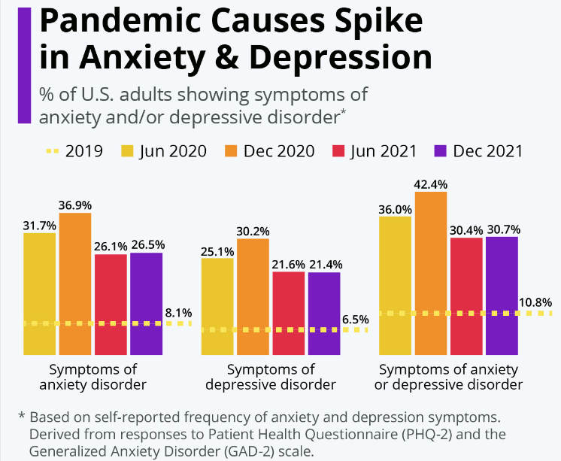
What is PASC and how it affects mental health?
PASC stands for post-acute sequelae of SARS-CoV-2 and is a term scientists are using to study the potential consequences of a SARS-CoV-2 infection.
According to the U.S. Census Bureau and the National Center for Health Statistics, more than 4 in 10 U.S. adults had developed symptoms of depression or anxiety by the end of 2020, a sharp increase over the results of a comparable survey conducted before the onset of the pandemic in 2019.

Slide 5
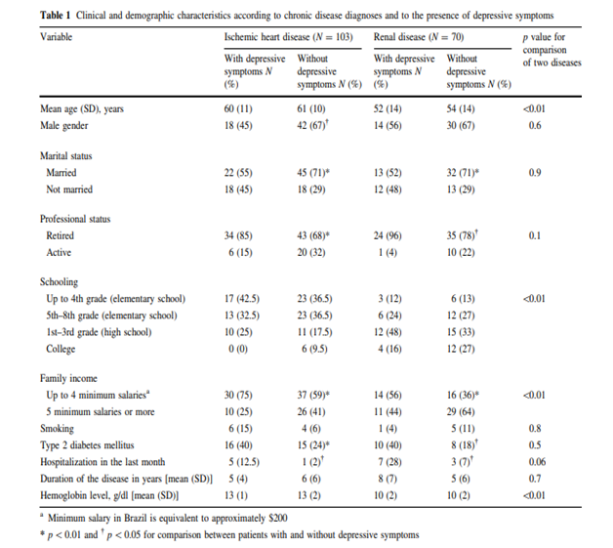
Prior Studies
Studies among patients diagnosed with chronic illnesses in Brazil indicate , lifestyle, comorbidity, substance abuse along with other socio-economic factors are responsible in causing mental disorder.

Slide 6
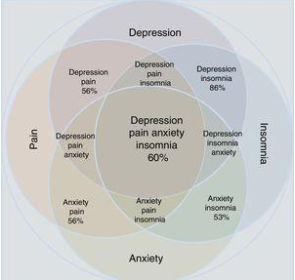
Prior Studies
A survey among 2069 medical student in China is used to analyze the effect of resilience, personality and social support on mental health. In the regression equation interaction between resilience and negative life events have shown to have the maximum effect.
A survey of WHO across 26 countries from all over the world suggests that diseases when combines with depression become worse.
Several studies in the past indicate a strong relation between chronic pain with anxiety and depression

Slide 7
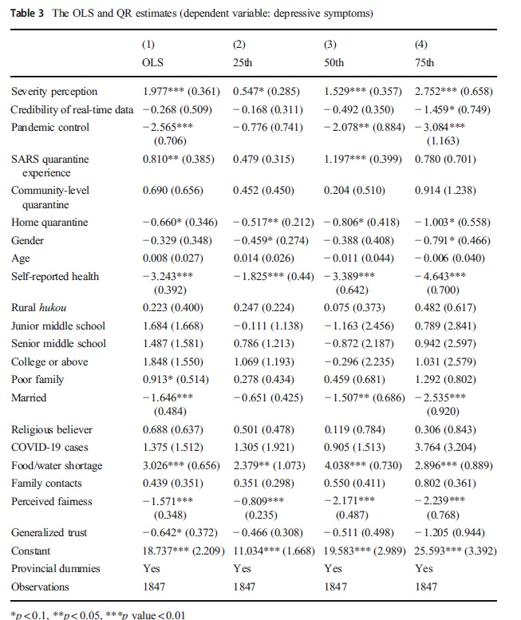
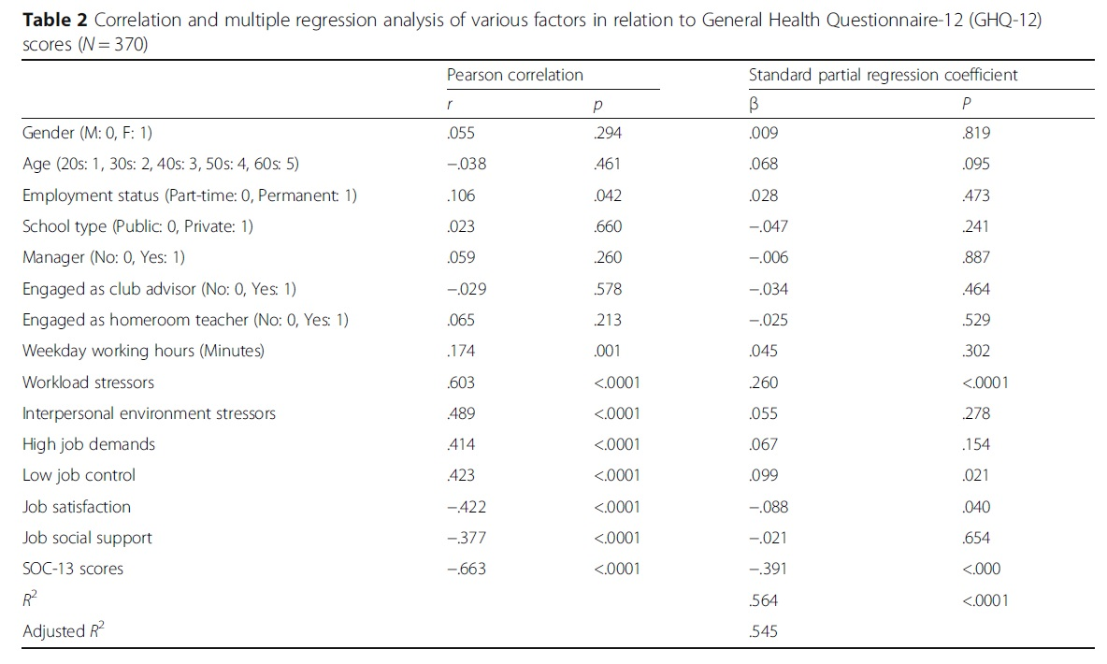
Research and theories:

Slide 8
Important contributing factors We have observed various research papers often take similar variables in consideration while conducting analysis on depression and anxiety disorder
Various chronic and diseases like cancer, diabetes, asthma etc.
Quality of life (QOL variables like hours of sleep, exercise etc)
Age , gender and race
Life events including military and currently in school
Substance abuse
Professional/work status
Family income
Pain and how to treat for said pain
Here is a list of variables which we have considered for our analysis - All Variables (1).xlsx

Slide 9
Predictor Table for Baseline Models
Predictor | Sign | Rational
age | -/+ | Age may or may not affect anxiety and depression levels.
sex | -/+ | Gender may or may not affect anxiety and depression levels.
education | + | More educated people may seek treatment sooner.
fammembers | - | More family members give a higher level of stress in the home as there are larger responsibilities, can lead to depression and anxiety
maxeducation | + | Higher education in the family might provide a good support system and an urging of a person struggling with anxiety and depression to get treatment
health | - for good health | Good health is less stress on the mind and body and a person will be less likely to have anxiety or depression
BMI | - for high BMI | Higher BMI indicates an unhealthy lifestyle that can cause stress on the body and cause anxiety/depression
Diffseeing | + | Difficulty seeing can leave a feeling of frustration and helplessness that can cause anxiety and depression
Diffhearing | + | Difficulty hearing can leave a feeling of frustration and helplessness that can cause anxiety and depression
Diffwalking | + | Difficulty walking can leave a feeling of frustration and helplessness that can cause anxiety and depression
Diffcomm | + | Difficulty communicating can leave a feeling of frustration and helplessness that can cause anxiety and depression

Slide 10
Predictor Table for Baseline Models (cont)
Diffrem | + | Difficulty remembering can leave a feeling of frustration and helplessness that can cause anxiety and depression
diffselfcare | + | Difficulty doing self care can leave a feeling of frustration and helplessness that can cause anxiety and depression
diffsocial | + | Difficulty socializing can leave a feeling of frustration and helplessness that can cause anxiety and depression
healthcareprov | + | Those providing health care can be severely affected by trauma from seeing sickness, injury and death, and can have higher levels of depression and anxiety
mentaltherapy | +/- | Those seeking mental health therapy might feel higher levels of anxiety and depression, but seeking out these levels might be a treatment that helps decrease these symptoms.
Sexualorientation | + for certain ones | Certain sexual orientations are not widely accepted in the community, increasing depression and anxiety levels
maritalstatus | +/- | Those who are in abusive relationships may feel depressed or anxious, but those who feel lonely may also be depressed or anxious.
Parentalstatus | + for having children | Having children can be stressful and there is also post-partum depression as well.
military | + | Ever being in active duty can cause those to have anxiety and depression from the stress of the military and the trauma of battle.

Slide 11
Predictor Table for Baseline Models (cont)
school | + | Those in school as adults are under stress as they have to deal with student debt, working, etc. This will lead to increased anxiety and depression levels.
work35 | + | Those who work full time or more may be under more stress due to higher responsibilities and less free time, increasing depression and anxiety levels.
familyincome | - | Higher family income indicates that those who need treatment for mental health can get it. There are also less financial stressors.
house | + for own | Renting indicates that a person has either not been able to settle down for long periods or cannot afford to own a house, which is higher stress and indicates more anxiety and depression.

Slide 12
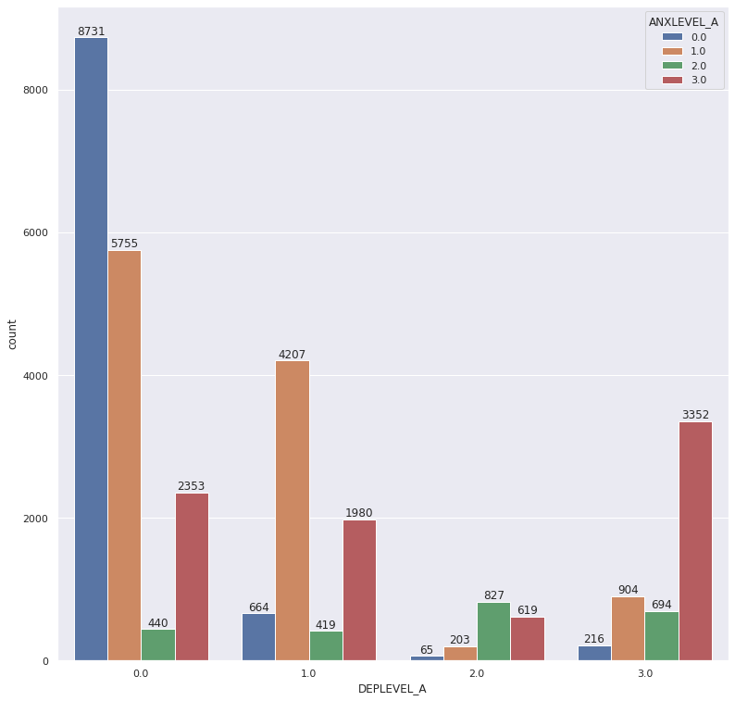
Anxiety level vs. Depression Level bar chart
From our current data, we can 53% correlation between anxiety and depression. Our research paper that we read suggested that correlation could be as high as 83%.

Slide 13
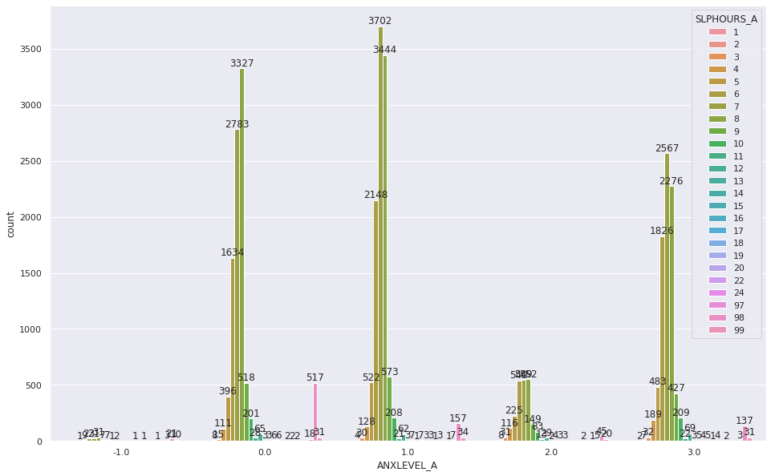
Sleep hours per day vs anxiety level

Slide 14
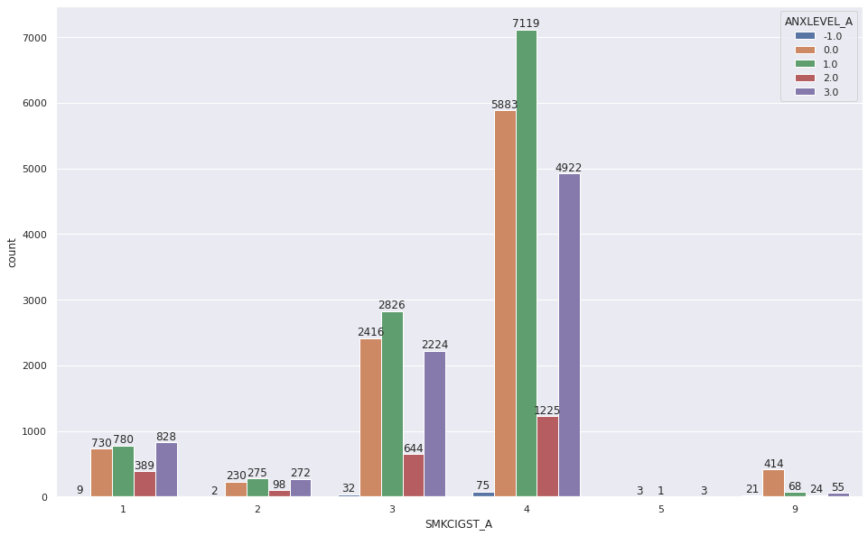
Smocking vs anxiety level

Slide 15
Models
We have two dependent variables
Level of depression
Level of anxiety
As of now we have created three models each for these two .
In first model we have considered all variables that can be termed as quality of life variables such as age, gender,family support, overall health , BMI etc.
In the next model, we have added variables related to different habits of a person , such as smoking, exercise, alcohol consumption,sleep patterns etc. This will help us analyze how we can improve on depression or anxiety by altering these habits.
In the third model , we have added other health issues that may alter mental health in a person, such as diabetes, heart diseases, asthma etc. This model gives us an picture about which patients are more vulnerable for depression or anxiety and based on this analysis the doctors can advise patients to undergo mental health check up as needed.
In addition to these, we plan to create a model to analyze how pain affects mental health in a person.

Slide 16
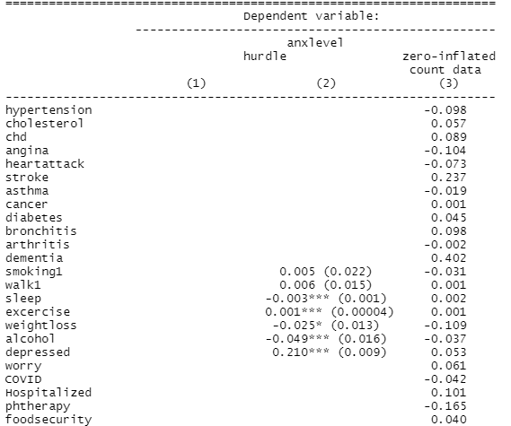
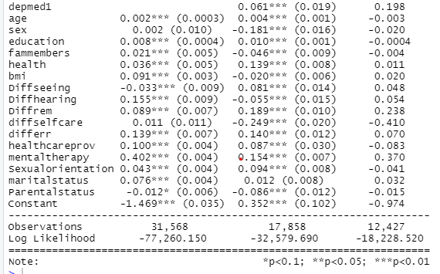
Stargazer - Anxiety

Slide 17
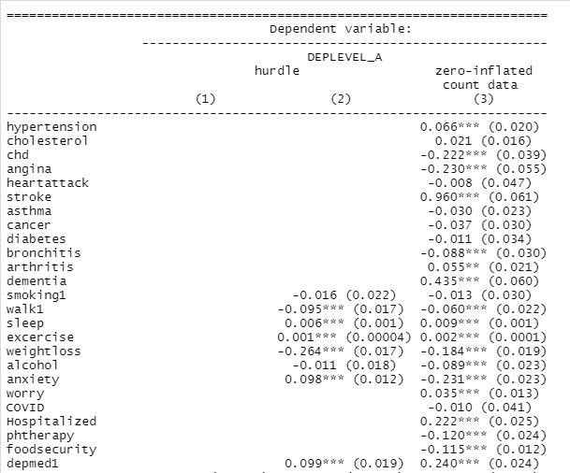
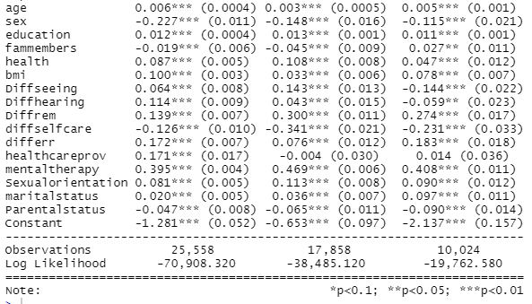
Stargazer - Depression

Slide 18
Recommendations
Zero Hurdle model was employed to determine the most appropriate analysis for predicting the depression and anxiety level in people.
From the stargazer output, to prevent anxiety it is recommended that health care and regular health checkup should be must. Increase in the cholesterol, stroke, diabetes, hospitalized and worry could increase the anxiety by 5%, 23%, 4%, 22% and 35% respectively.
Smoking and alcohol intake can decrease the level of anxiety by 3-4% which led to the possibilities that smoking and drinking to lesser your anxiety for shorter time period.
For the depression level, increase in the cholesterol, stroke, hospitalized and worry could increase depression by 2%, 96%, 22% and 3% respectively.
Therapy and could also decrease the level of depression by 12%. Therefore, that should be highly recommended to the patient of depression.

Slide 19
References
Rayner L, Hotopf M, Petkova H, Matcham F, Simpson A, McCracken LM. Depression in patients with chronic pain attending a specialised pain treatment centre: prevalence and impact on health care costs. Pain. 2016 Jul;157(7):1472-9. doi: 10.1097/j.pain.0000000000000542. PMID: 26963849; PMCID: PMC4912238.
Cruz, Luciane & Fleck, Marcelo & Polanczyk, Carisi. (2009). Depression as a determinant of quality of life in patients with chronic disease: Data from Brazil. Social psychiatry and psychiatric epidemiology. 45. 953-61. 10.1007/s00127-009-0141-2.
Moussavi S, Chatterji S, Verdes E, Tandon A, Patel V, Ustun B. Depression, chronic diseases, and decrements in health: results from the World Health Surveys. Lancet. 2007 Sep 8;370(9590):851-8. doi: 10.1016/S0140-6736(07)61415-9. PMID: 17826170.
Farren GL, Zhang T, Gu X, Thomas KT. Sedentary behavior and physical activity predicting depressive symptoms in adolescents beyond attributes of health-related physical fitness. J Sport Health Sci. 2018 Oct;7(4):489-496. doi: 10.1016/j.jshs.2017.03.008. Epub 2017 Mar 22. PMID: 30450259; PMCID: PMC6226422.

Slide 20
Reference
Lu, H., Nie, P. & Qian, L. Do Quarantine Experiences and Attitudes Towards COVID-19 Affect the Distribution of Mental Health in China? A Quantile Regression Analysis. Applied Research Quality Life 16, 1925–1942 (2021). https://doi.org/10.1007/s11482-020-09851-0
Kuwato, M., Hirano, Y. Sense of coherence, occupational stressors, and mental health among Japanese high school teachers in Nagasaki prefecture: a multiple regression analysis. BMC Public Health 20, 1355 (2020). https://doi.org/10.1186/s12889-020-09475-x
Schilling, E.A., Aseltine, R.H. & Gore, S. Adverse childhood experiences and mental health in young adults: a longitudinal survey. BMC Public Health 7, 30 (2007). https://doi.org/10.1186/1471-2458-7-30
Psychosocial job quality and mental health among young workers: a fixed-effects regression analysis using 13 waves of annual data by Allison Milner, PhD,1 Lauren Krnjacki, MPH,2 Anthony D LaMontagne, ScD12 | https://www-jstor-org.ezproxy.lib.usf.edu/stable/pdf/26386160.pdf?refreqid=excelsior%3A079549e7a065c0d450786a64c476eea7&ab_segments=&origin=

